Slide 1
Tutorial machine learning in solid mechanics
Task 2 – Hyperelasticity
Notes:
Hello, today I would like to present you the second task
sheet which deals with the modeling of hyperelasticity

Slide 2
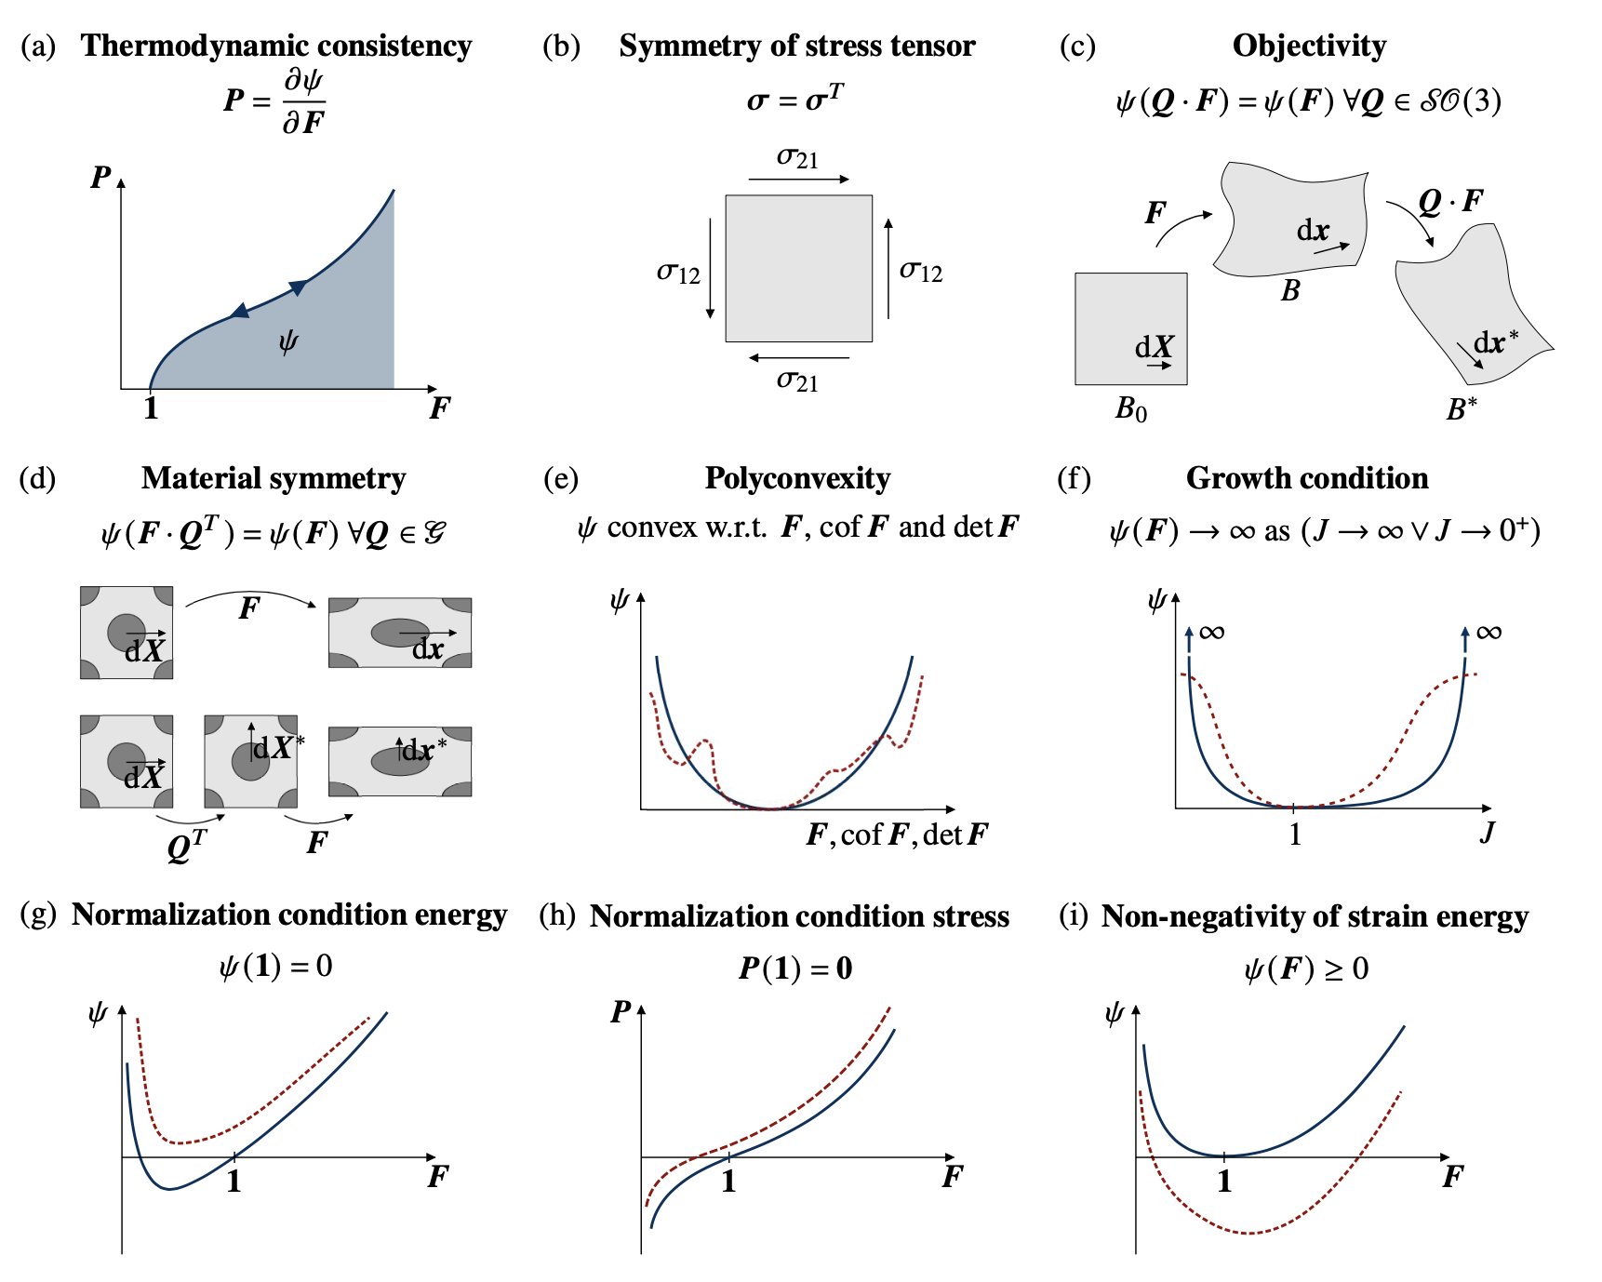
Embedding physics in ML-models
…
…
…
…
input layer
hidden layer
output layer
Notes:
Here you can see a standard FFNN
And here the constitutive conditions which we will consider in this task
Can we combine physics with classical ML-Models?
What are the advantages and disadvantages?

Slide 3
Embedding physics in ML-models
Physics
[1]
[1] https://doi.org/10.1016/j.jmps.2023.105363
…
…
…
…
input layer
hidden layer
output layer
Notes:
Here you can see a standard FFNN
And here the constitutive conditions which we will consider in this task
Can we combine physics with classical ML-Models?
What are the advantages and disadvantages?

Slide 4
Embedding physics in ML-models
Physics
[1]
…
…
…
…
input layer
hidden layer
output layer
[1] https://doi.org/10.1016/j.jmps.2023.105363
Notes:
Here you can see a standard FFNN
And here the constitutive conditions which we will consider in this task
Can we combine physics with classical ML-Models?
What are the advantages and disadvantages?

Slide 5
Embedding physics in ML-models
Physics
If we embedding physics in our ML-Models which impact has this on …
the size of the NN?
the amount of data?
the generalization behavior of the model?
inductive bias?
…
…
…
…
input layer
hidden layer
output layer
Notes:
Here are a few important questions which I will answer in this presentation

Slide 6
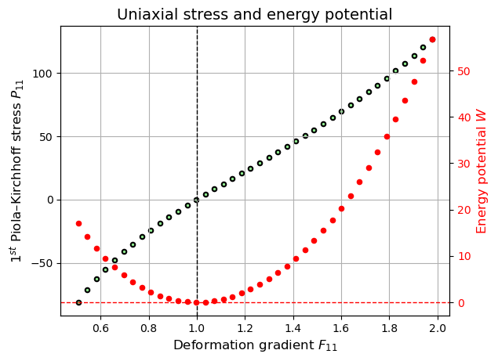
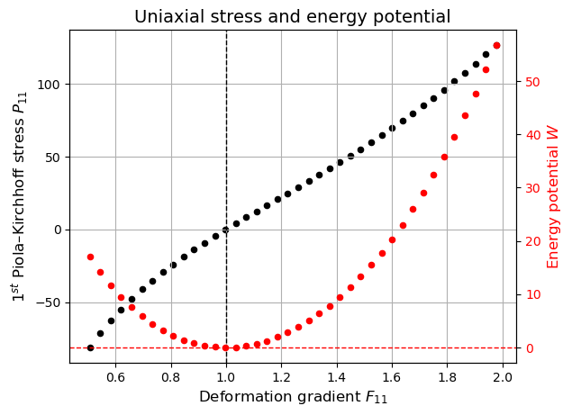
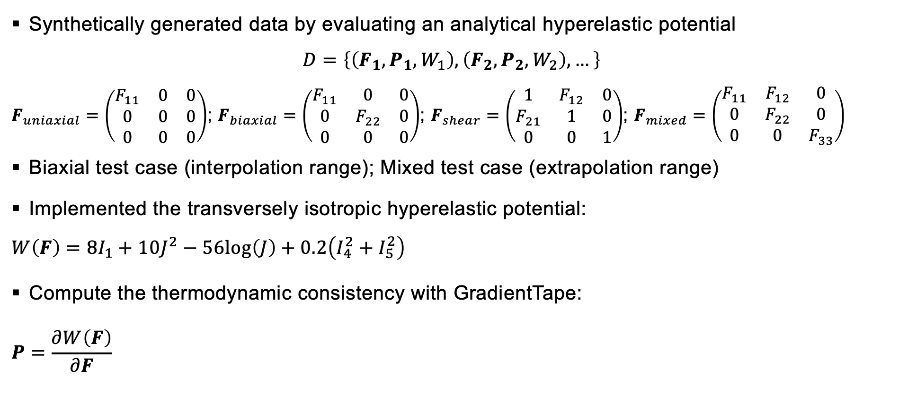
Data preparation
Synthetically generated data by evaluating an analytical hyperelastic potential
$$D=\left\{\left(F_{1}, P_{1}, W_{1}\right),\left(F_{2}, P_{2}, W_{2}\right), …\right\}$$
$F_{uniaxial}=\left(\begin{matrix}F_{11} & 0 & 0 \\ 0 & 0 & 0 \\ 0 & 0 & 0\end{matrix}\right)$; $F_{biaxial}=\left(\begin{matrix}F_{11} & 0 & 0 \\ 0 & F_{22} & 0 \\ 0 & 0 & 0\end{matrix}\right)$; $F_{shear}=\left(\begin{matrix}1 & F_{12} & 0 \\ F_{21} & 1 & 0 \\ 0 & 0 & 1\end{matrix}\right)$; $F_{mixed}=\left(\begin{matrix}F_{11} & F_{12} & 0 \\ 0 & F_{22} & 0 \\ 0 & 0 & F_{33}\end{matrix}\right)$
Biaxial test case (interpolation range); Mixed test case (extrapolation range)
Implemented the transversely isotropic hyperelastic potential:
$$W\left(F\right)=8I_{1}+10J^{2}−56log\left(J\right)+0.2\left(I_{4}^{2}+I_{5}^{2}\right)$$
Compute the thermodynamic consistency with GradientTape:
$$P=\frac{∂W\left(F\right)}{∂F}$$
Notes:
-The first task consisted mainly of data preparation and data visualization
The data is generated synthetically by evaluating a hyperelastic potential
The dataset consists of triplets for the corresponding deformation gradient tensor F, the Stress tensor, and the strain energy density
We have different kind of deformation: uniaxial, biaxial, shear, mixed
A uniaxial load path is shown here as an example

Slide 7
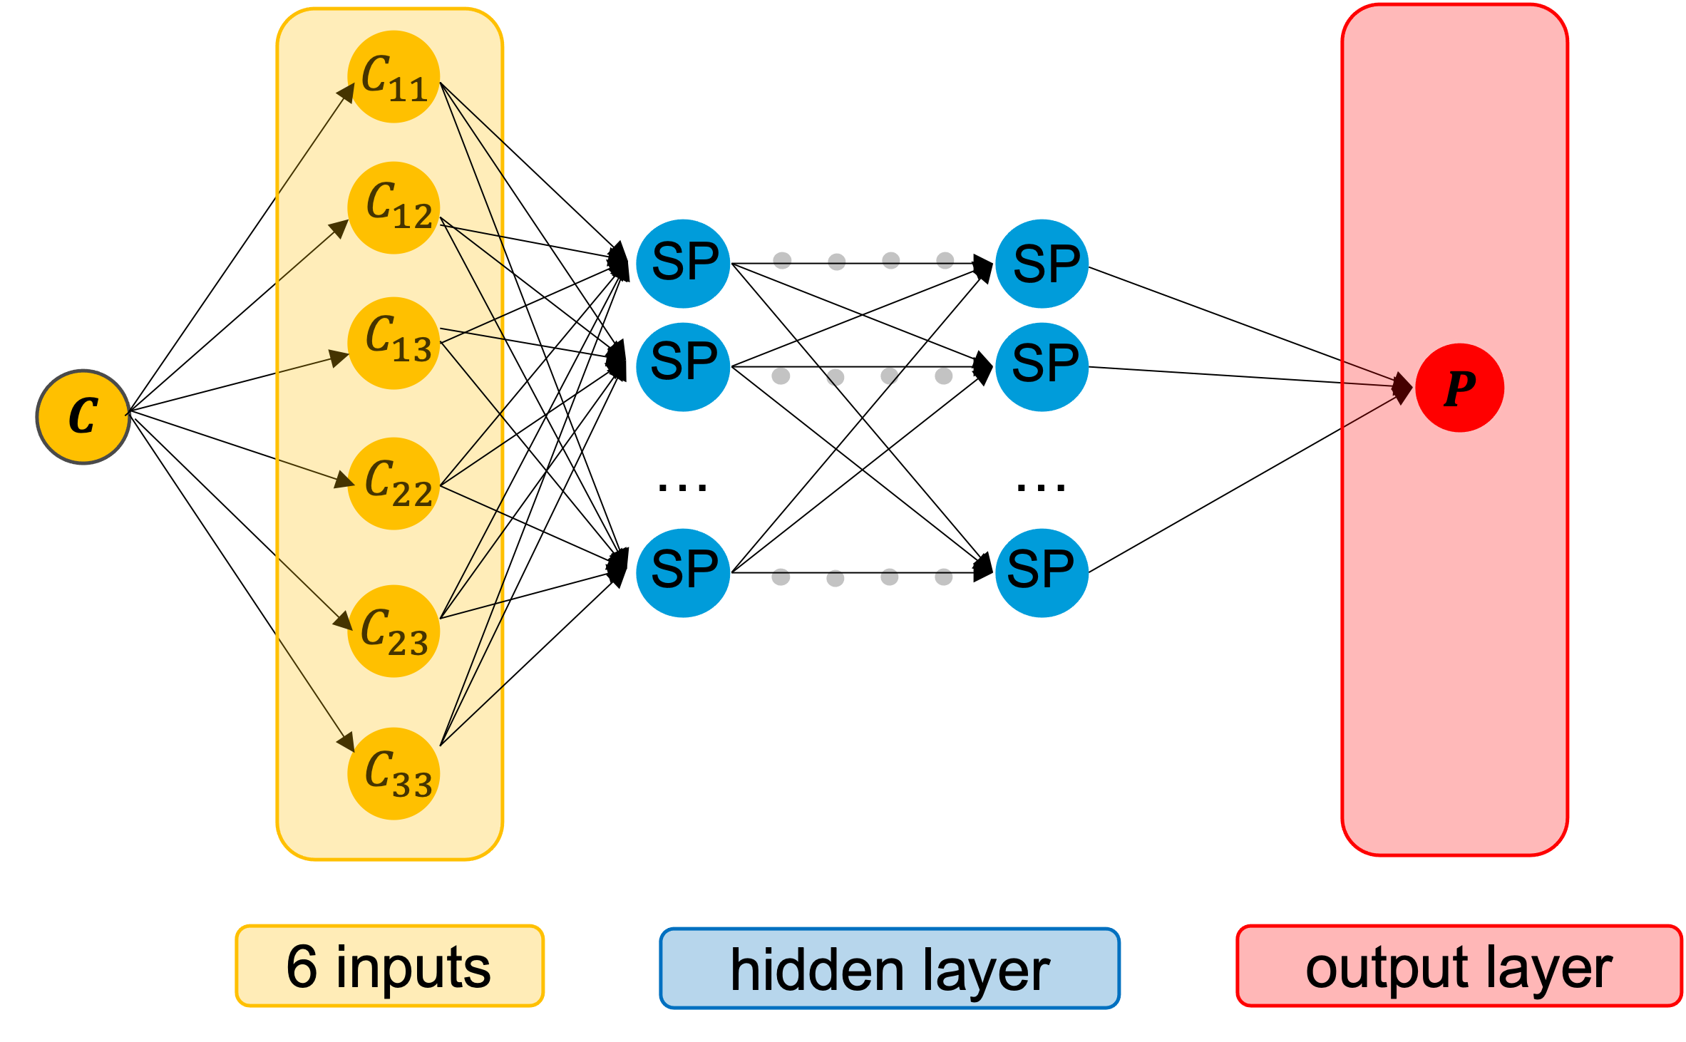
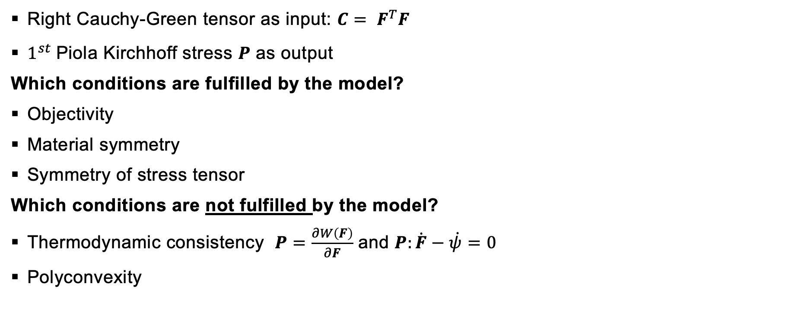
Neural network model – A naïve approach
Right Cauchy-Green tensor as input: $C= F^{T}F$
$1^{st}$Piola Kirchhoff stress $P$ as output
Which conditions are fulfilled by the model?
Objectivity
Material symmetry
Symmetry of stress tensor
Which conditions are not fulfilled by the model?
Thermodynamic consistency $P=\frac{∂W\left(F\right)}{∂F}$ and $P:\dot{F}−\dot{ψ}=0$
Polyconvexity
Notes:
-In the second task, a naive model was to be implemented and trained in order to finally assess the quality of this model => is it good or not good!
As input to the model we use the six independent components of the right Cauchy Green tensor. We map the input directly to P, as output
Conditions which are fulfilled, and which are not fulfilled

Slide 8
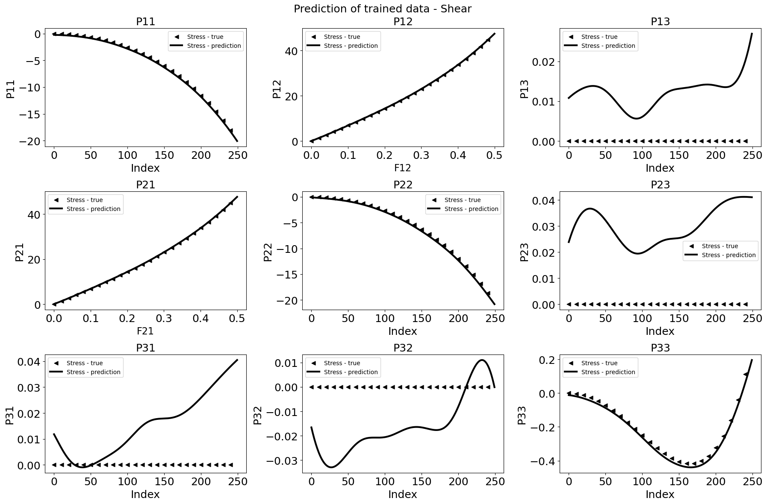
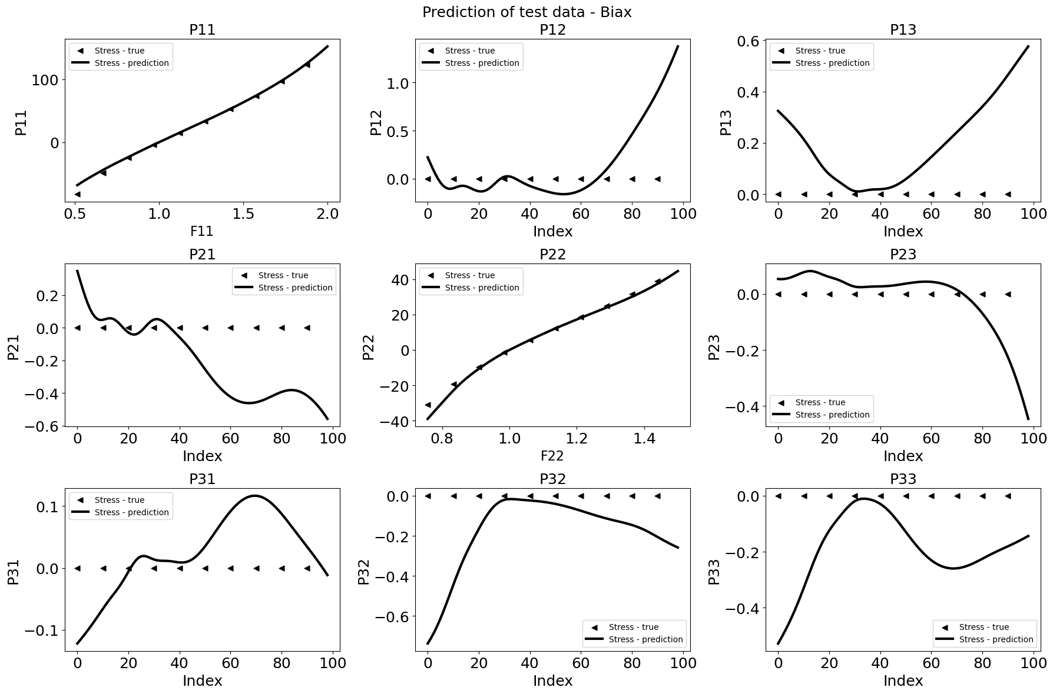
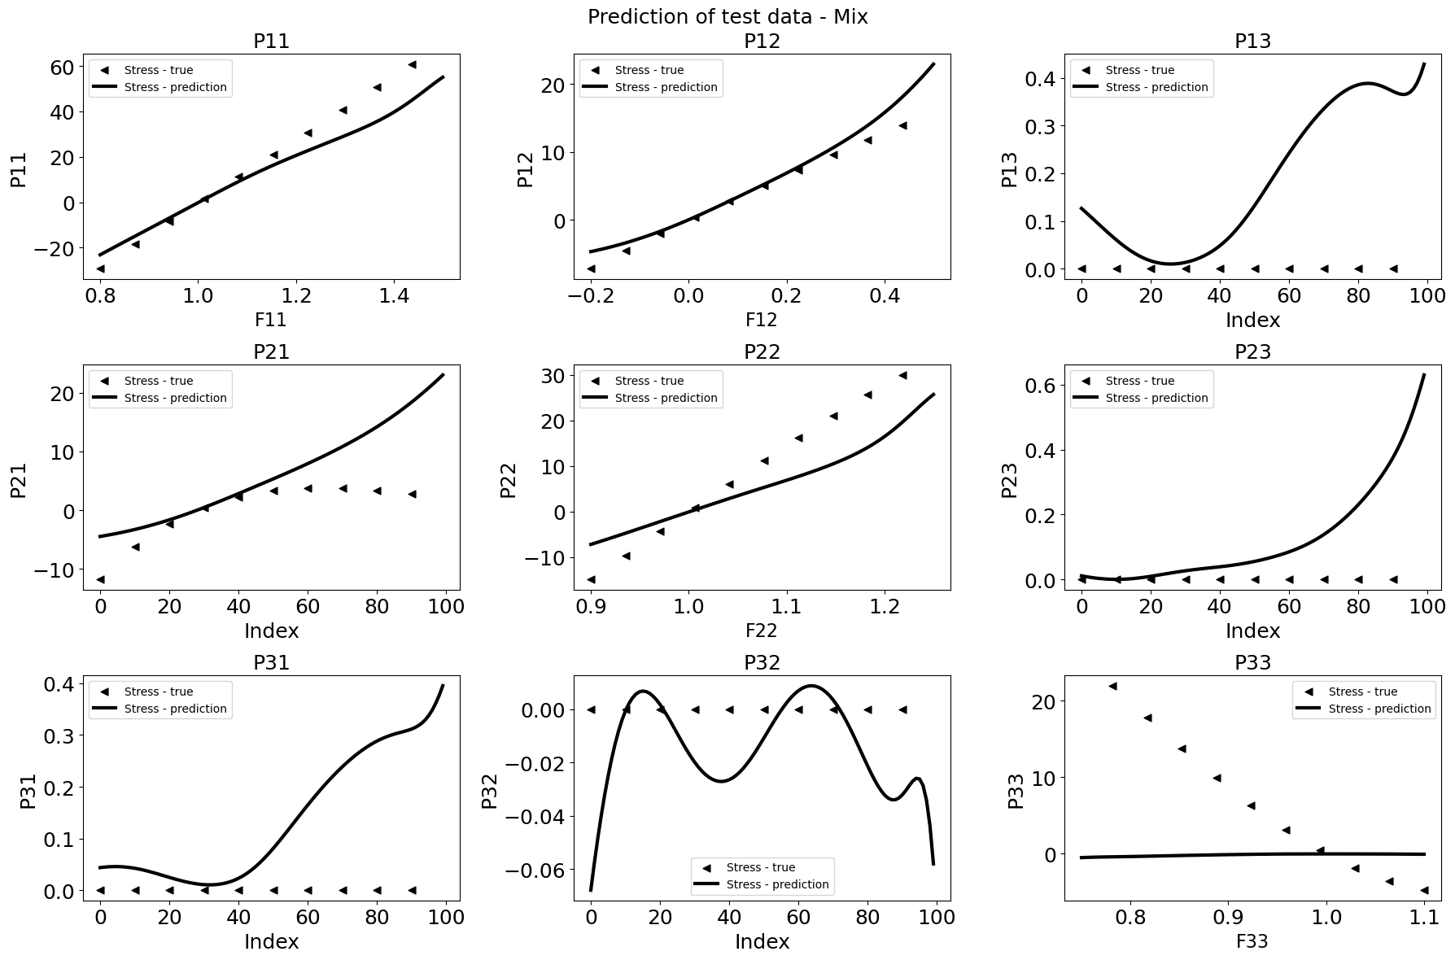
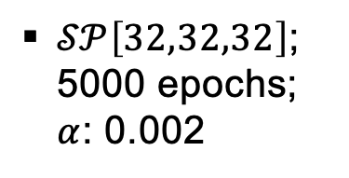
Neural network model – A naïve approach
$𝒮𝒫\left[32,32,32\right]$; 5000 epochs; $α$: 0.002
Notes:
- Here is shown the results for the naïve model.
- You can clearly see that the model can represent the data with which it was trained very well and unseen data which is in the interpolation range

Slide 9
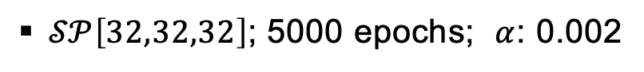
Neural network model – A naïve approach
$𝒮𝒫\left[32,32,32\right]$; 5000 epochs; $α$: 0.002
Able to interpolate data
Not able to extrapolate data
Model does not behave physically sensible, as among other things, the thermodynamic consistency is not fulfilled!
This means the “generalization” of the naïve model is not good.
We therefore need to find a new approach and try to fulfill the conditions
Notes:
Able to interpolate data
Not able to extrapolate data
Because the model does not fulfill the thermodynamic consistency, it cannot represent the physics either. This has an impact of the generailzation behavior.
To increase the generalization behavior we need a new approach and try to fulfill more conditions

Slide 10
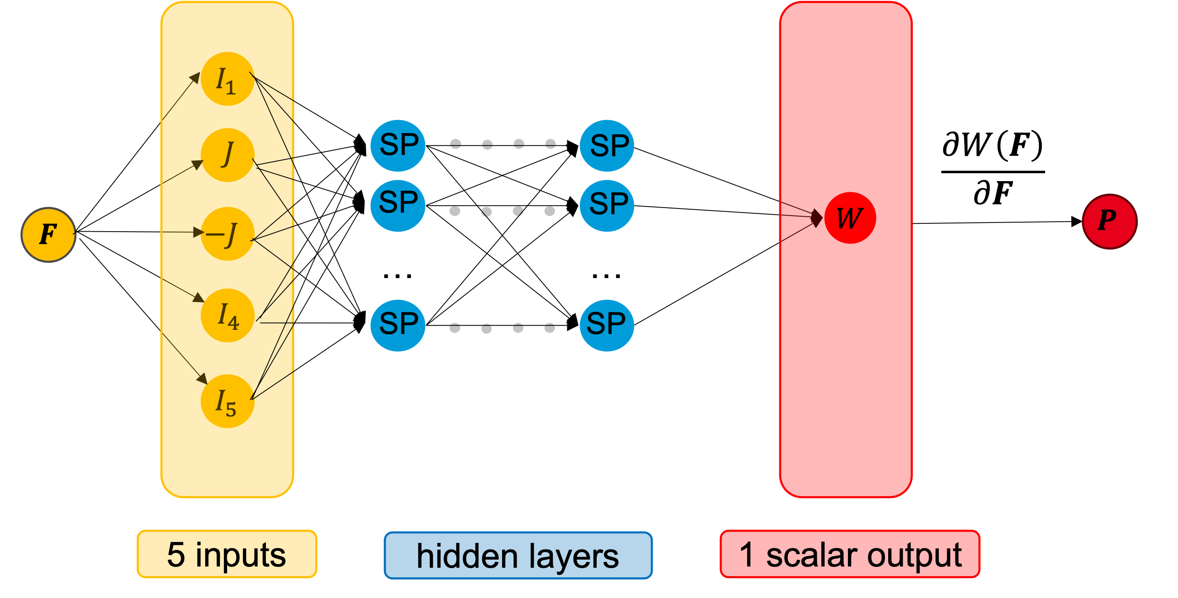
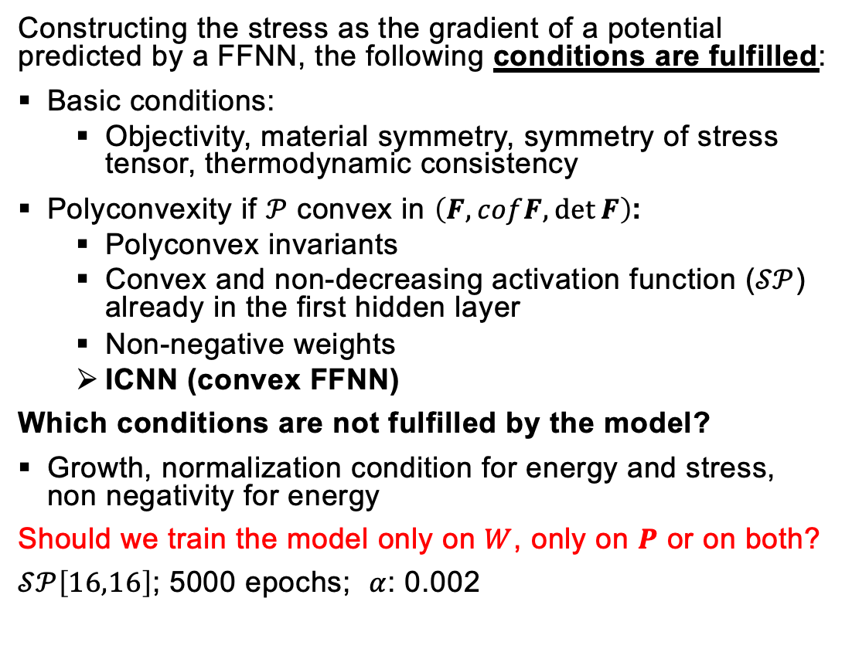
Physics-augmented neural network - Invariant-based PANN model
Constructing the stress as the gradient of a potential predicted by a FFNN, the following conditions are fulfilled:
Basic conditions:
Objectivity, material symmetry, symmetry of stress tensor, thermodynamic consistency
Polyconvexity if $𝒫$ convex in $\left(F, cofF,\det{F}\right)$:
Polyconvex invariants
Convex and non-decreasing activation function ($𝒮𝒫$) already in the first hidden layer
Non-negative weights
ICNN (convex FFNN)
Which conditions are not fulfilled by the model?
Growth, normalization condition for energy and stress, non negativity for energy
Should we train the model only on $W$, only on $P$ or on both?
$𝒮𝒫\left[16,16\right]$; 5000 epochs; $α$: 0.002
Notes:
In task three, we now implement a PANN, a so-called invariant-based model => We also use the same data set here!
By constructing the stress as the gradient of the strain energy density predicted directly by a FFNN, we automatically fulfill the following conditions:
- Objectivity, material symmetry, symmetry of stress tensor and the thermodynamic consistency
To ensure Polyconvexity, we use …
- polyconvex invariants
- Convex anf non-decreasing activation function already in the first hidden layer
-Non-negative weights
This is called ICNN

Slide 11
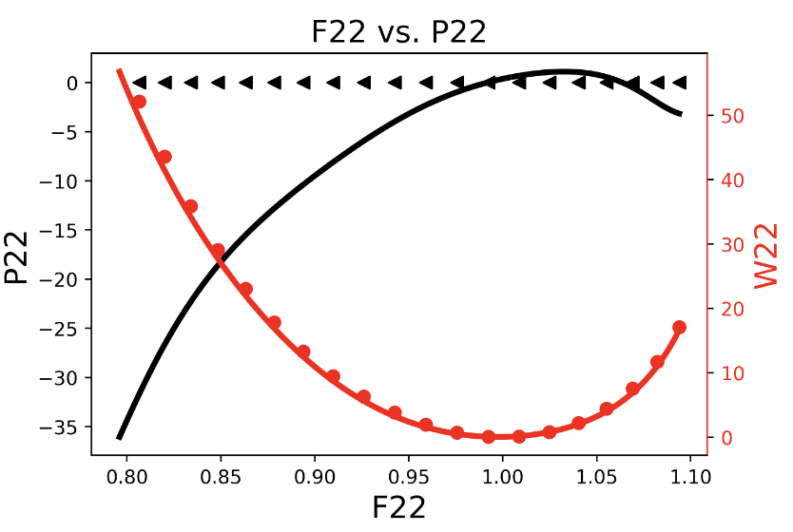
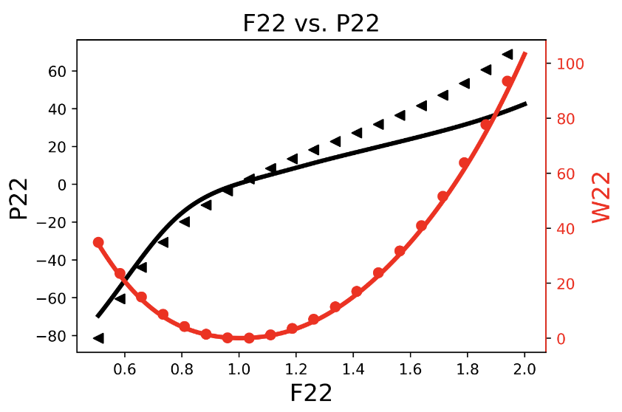
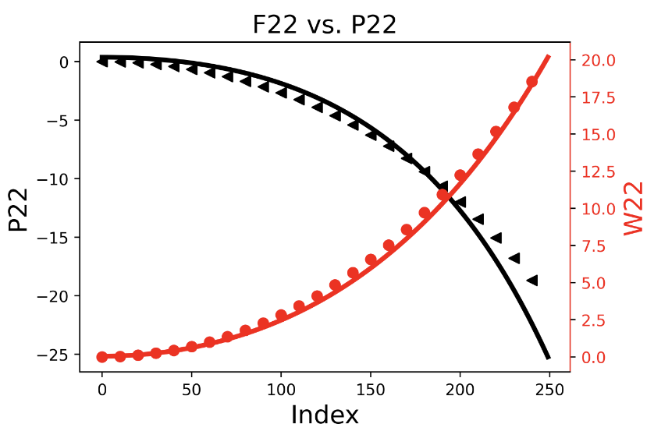
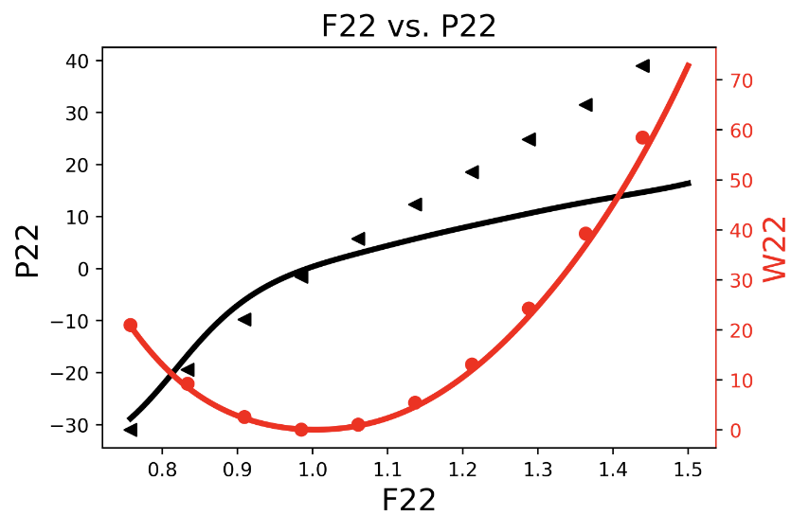
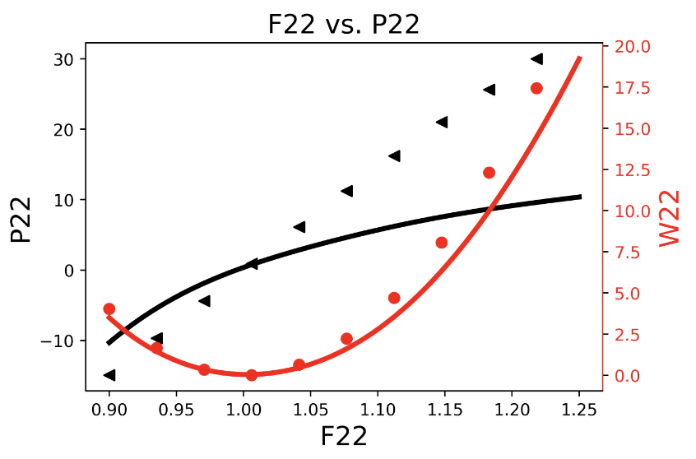
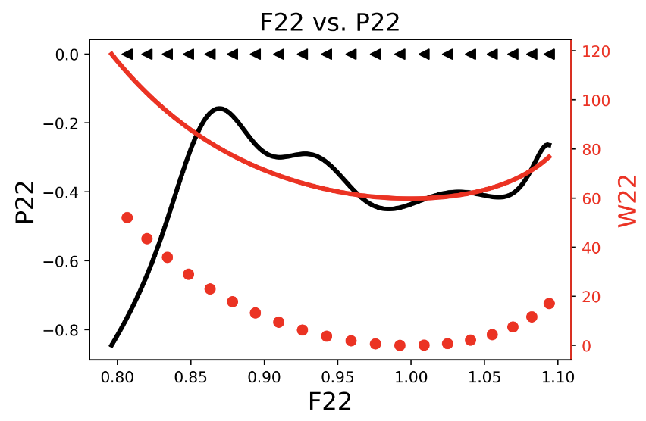
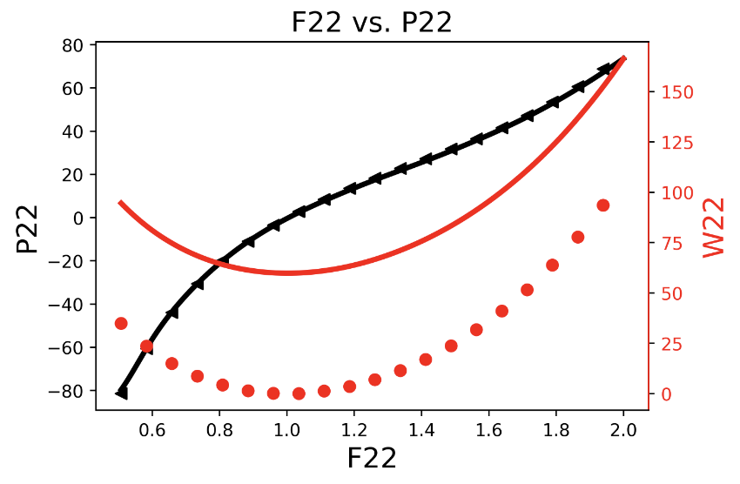
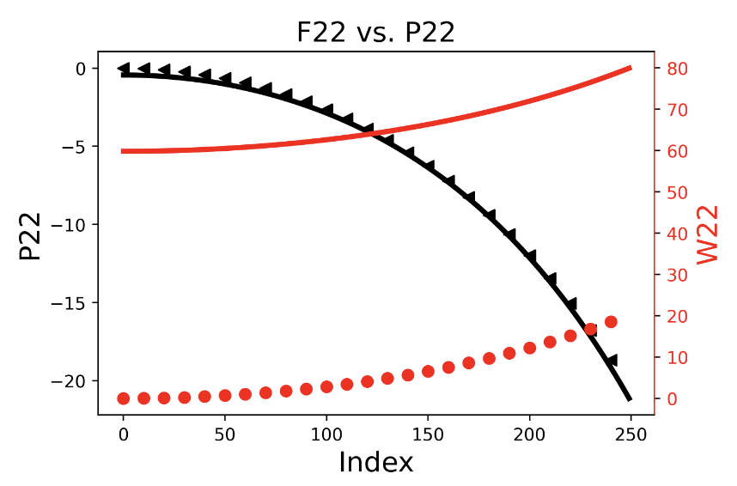
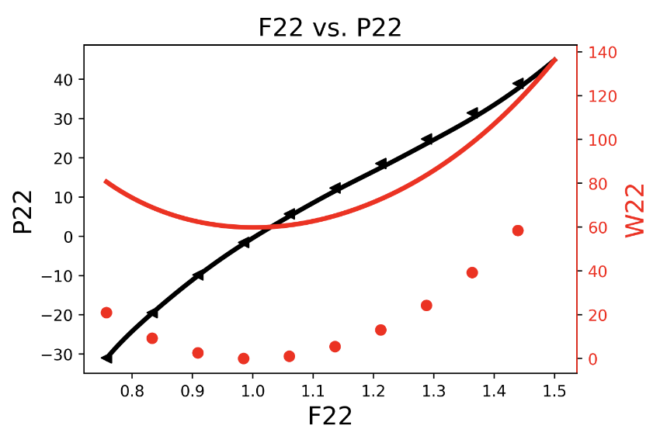
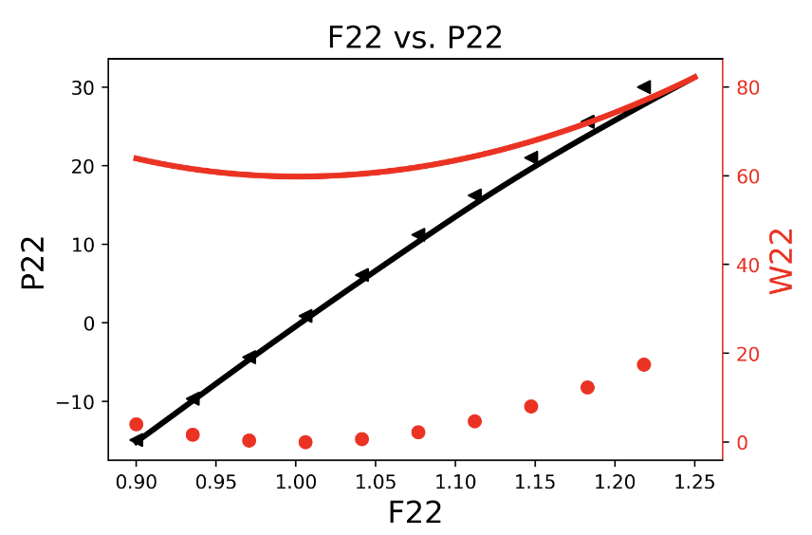
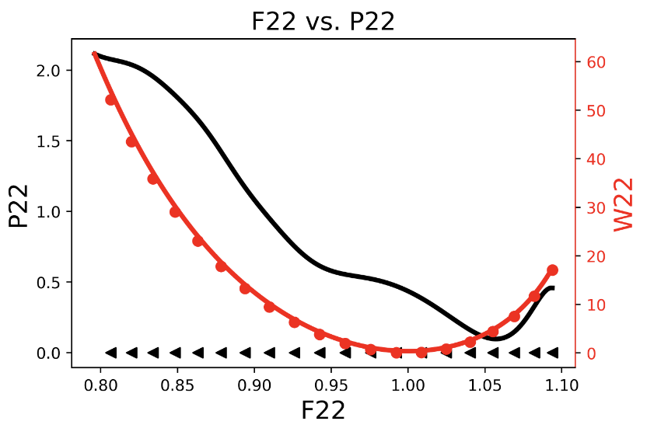
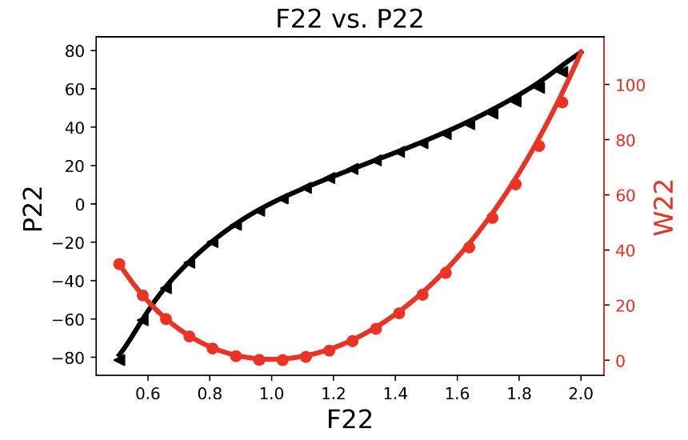
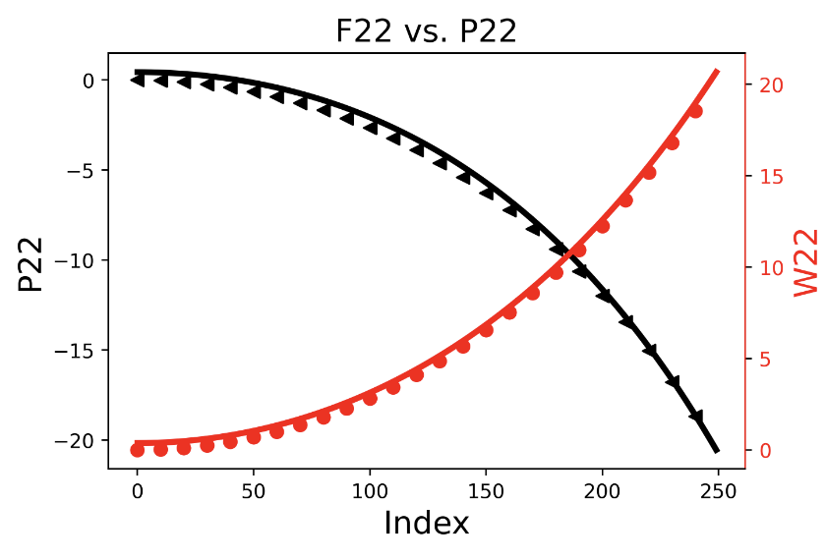
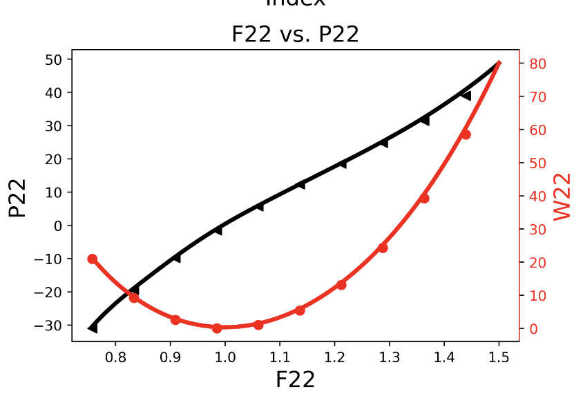
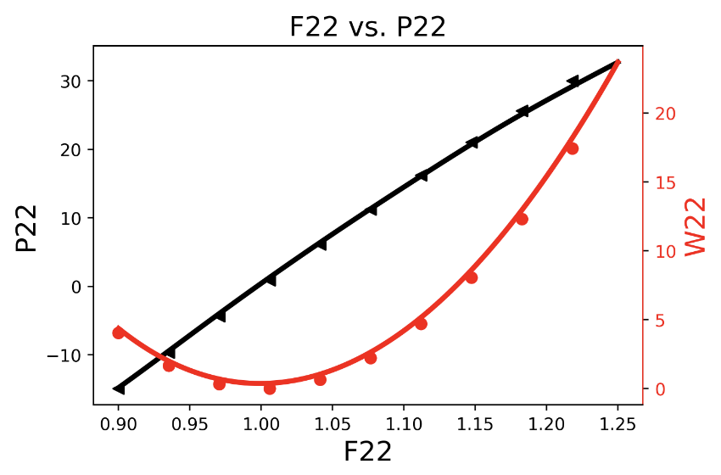
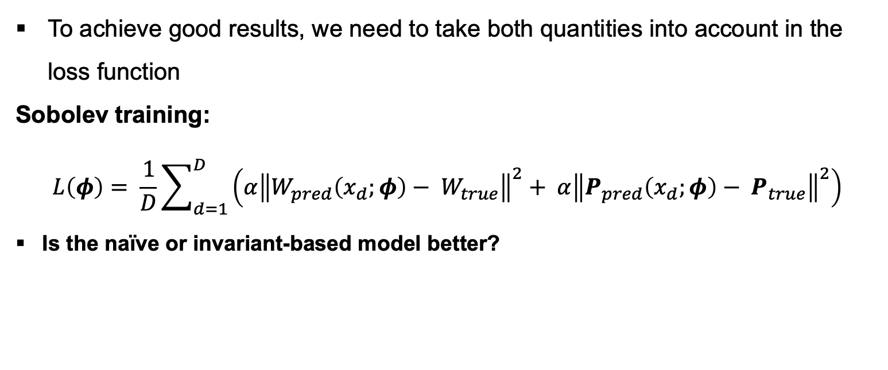
Influence of loss function on results
Uniaxial
Biaxial
Shear
Biaxial test
Mixed test
Train on W
To achieve good results, we need to take both quantities into account in the loss function
Sobolev training:
$$L\left(φ\right)= \frac{1}{D}\sum_{d=1}^{D}{\left(α{\left\|W_{pred}\left(x_{d};φ\right)− W_{true}\right\|}^{2}+ α{\left\|P_{pred}\left(x_{d};φ\right)− P_{true}\right\|}^{2}\right)}$$
Is the naïve or invariant-based model better?
Train on P
Train on both

Slide 12


Comparison between – Naïve and invariant-based model
$$𝒮𝒫\left[32,32,32\right]$$
$$𝒮𝒫\left[16,16\right]$$
PANN is able to …
interpolate the calibration data set
predict unseen load cases
with a much smaller NN size.
Generalization behavior increases the more physics is taken into account!
Notes:
Key message: The more constitutive conditions are taken into account the better the generalization behavior. In the next Task we will see the impact on the amount of training data, the size of the NN and inductive bias

Slide 13
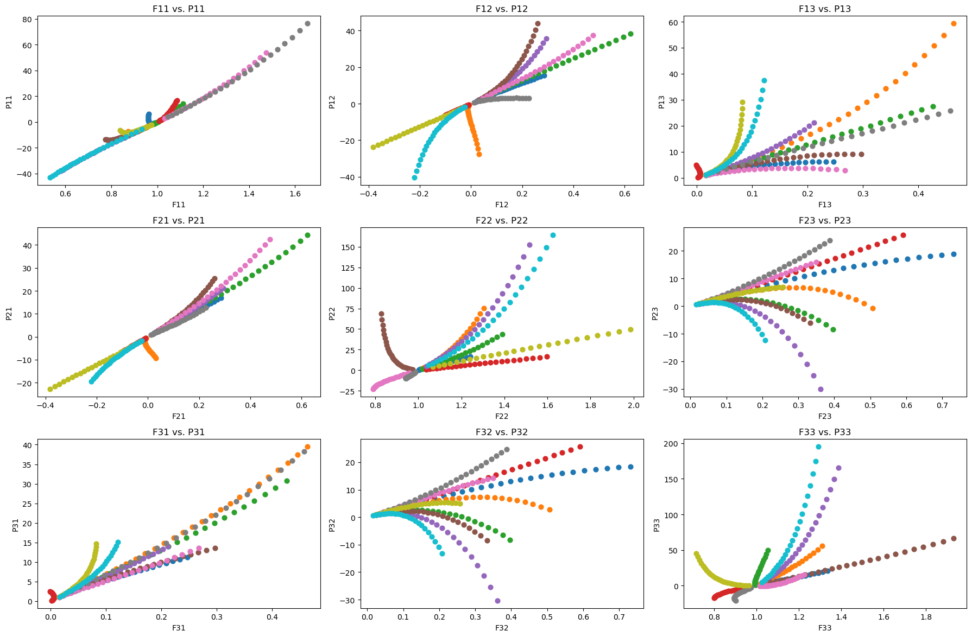
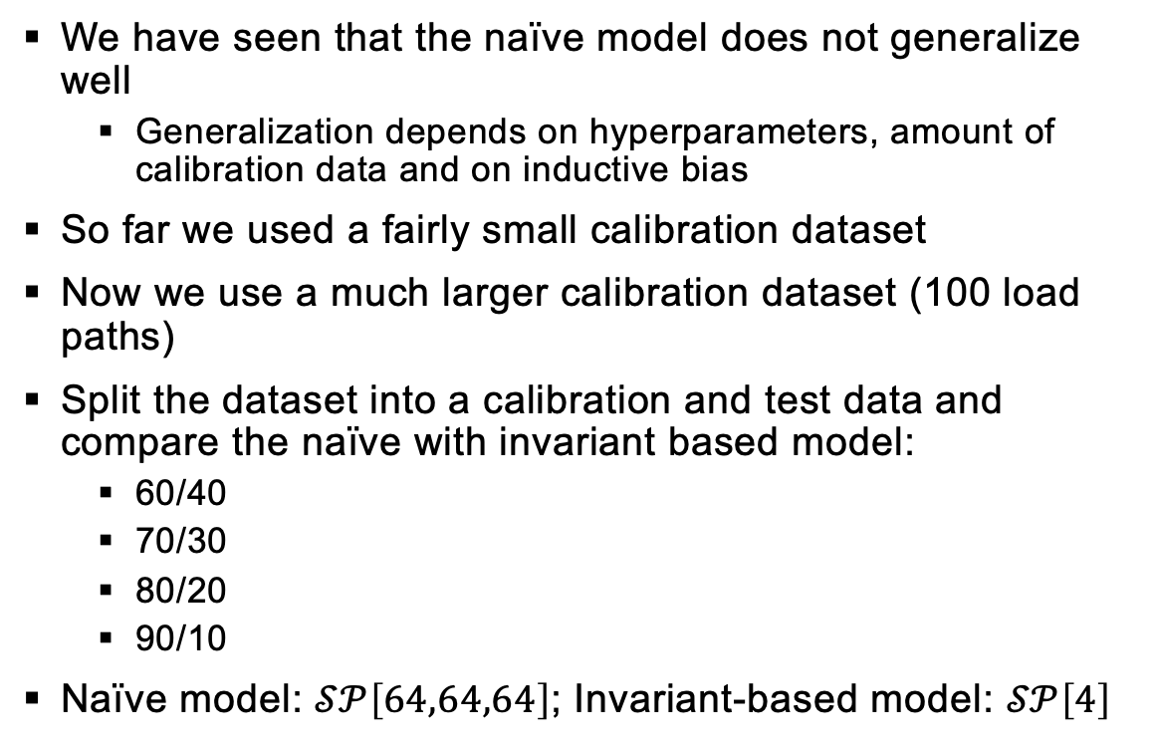
Concentric sampled deformation gradients – Generalization of NN’s
We have seen that the naïve model does not generalize well
Generalization depends on hyperparameters, amount of calibration data and on inductive bias
So far we used a fairly small calibration dataset
Now we use a much larger calibration dataset (100 load paths)
Split the dataset into a calibration and test data and compare the naïve with invariant based model:
60/40
70/30
80/20
90/10
Naïve model: $𝒮𝒫\left[64,64,64\right]$; Invariant-based model: $𝒮𝒫\left[4\right]$
Notes:
Now we have a data set which consists 5000 load paths and and 10 of these are shown here.
We have seen that the naïve model does not generalize well, but this depends also on the hyperparameters, amount of data and on inductive bias which we should investigate in this task

Slide 14
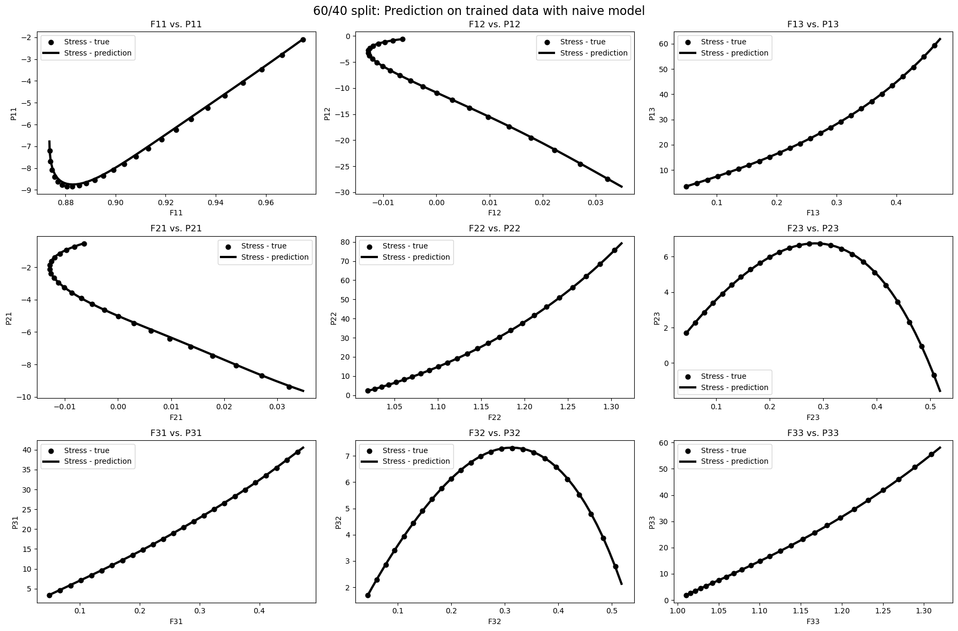
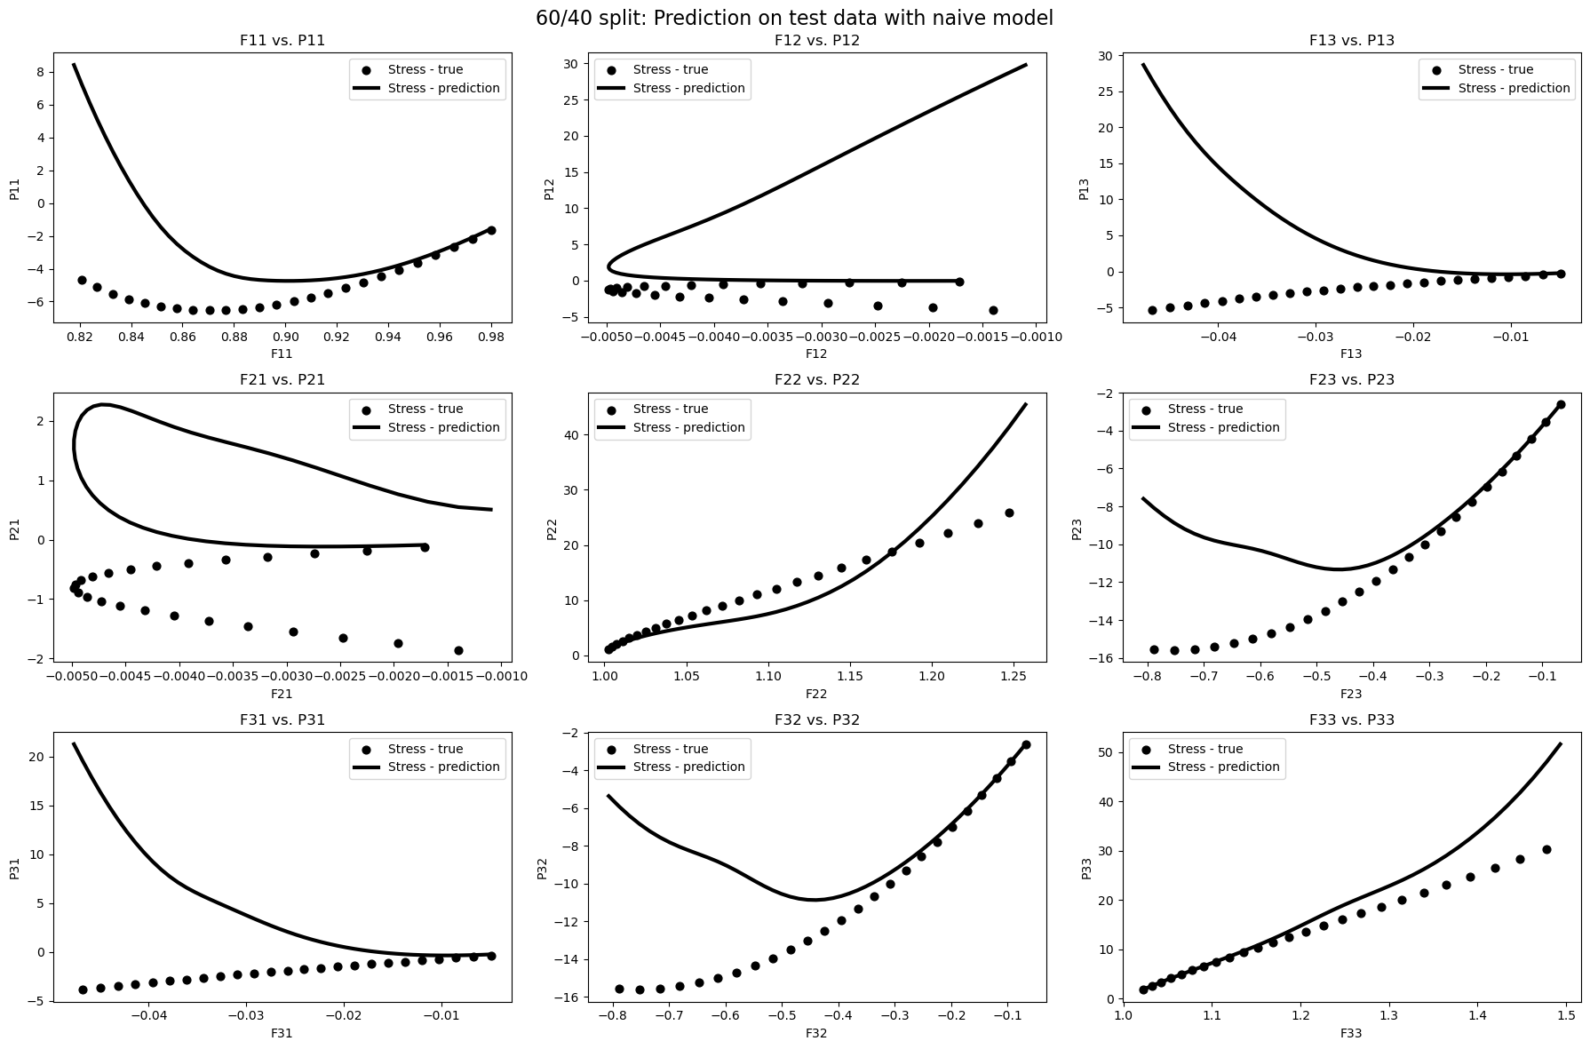
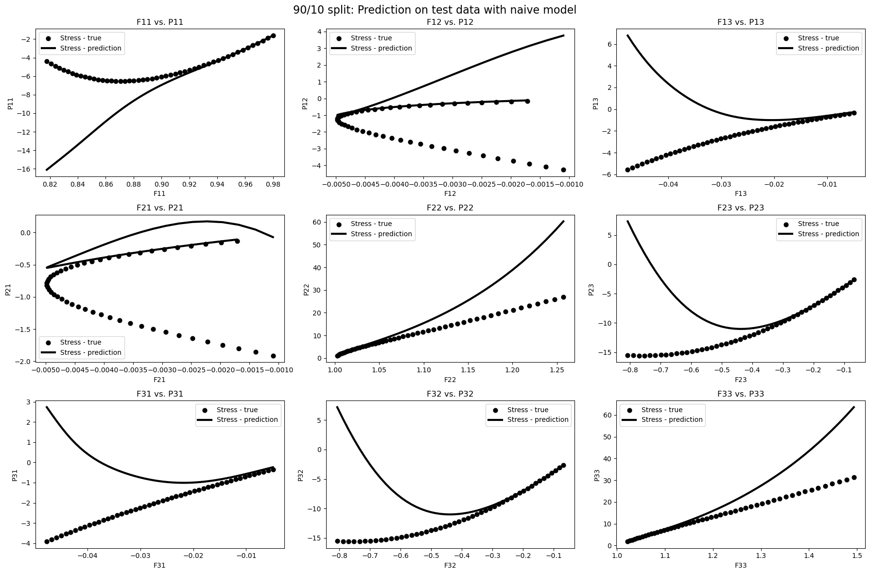
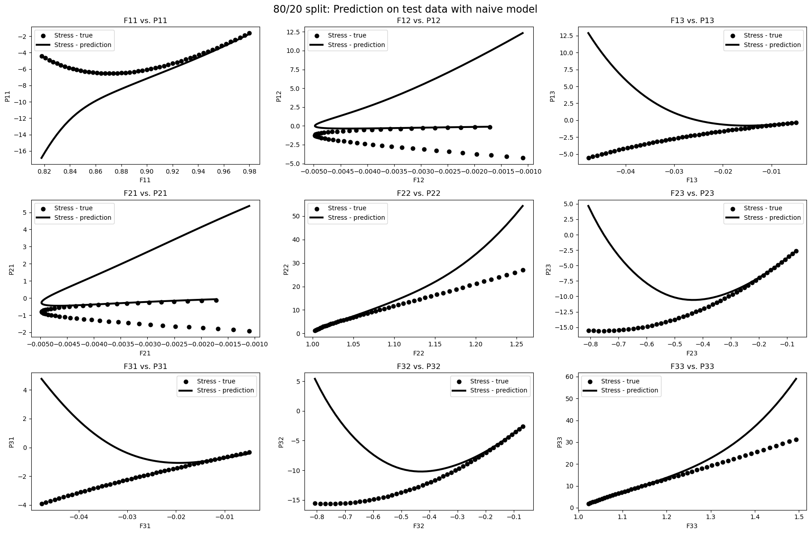
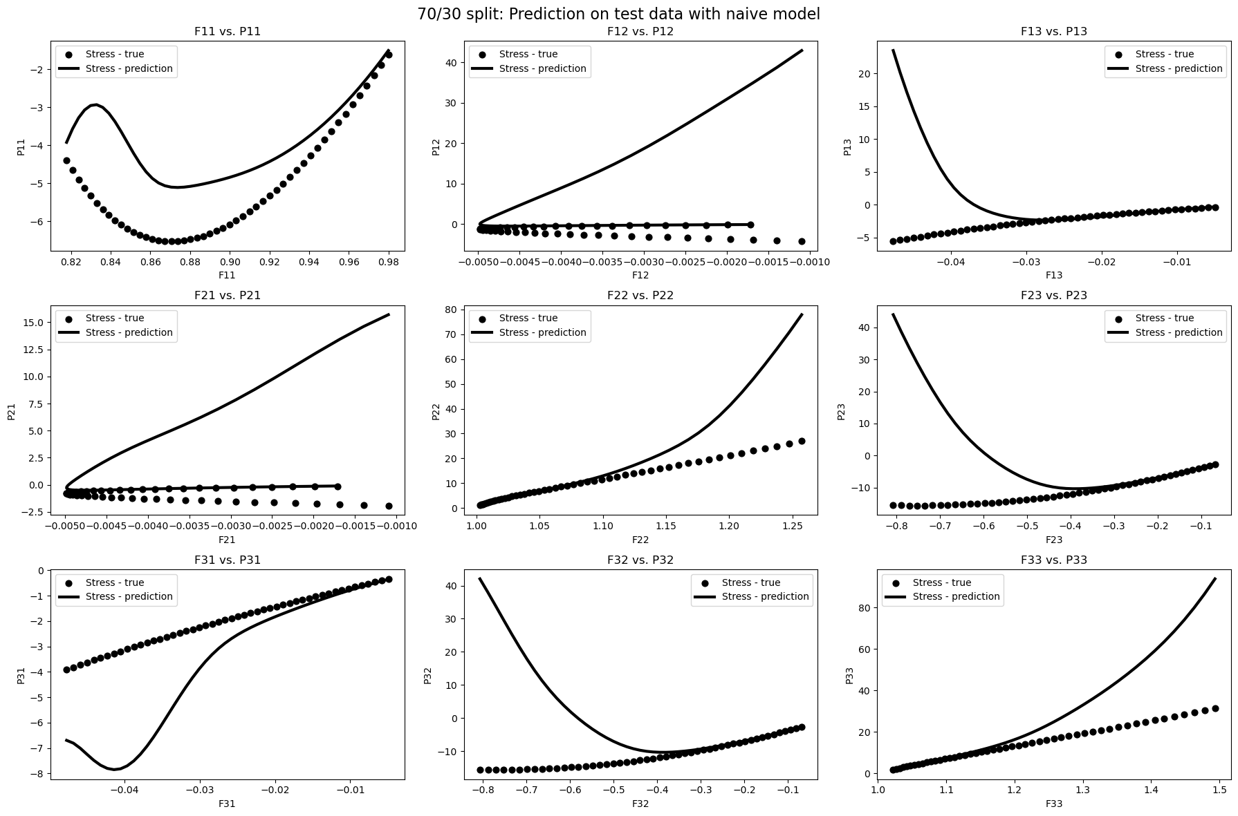
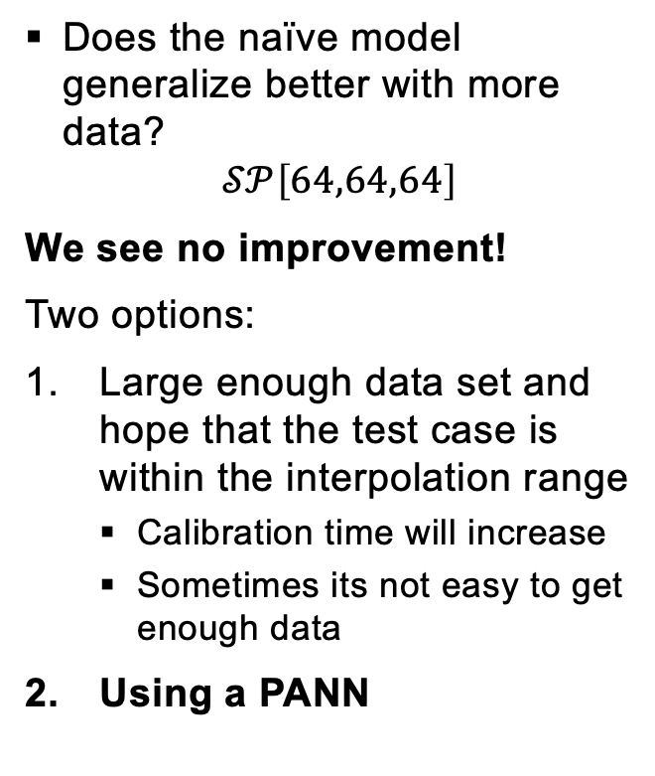
Concentric sampled deformation gradients – Generalization of NN’s
Does the naïve model generalize better with more data?
$$𝒮𝒫\left[64,64,64\right]$$
We see no improvement!
Two options:
Large enough data set and hope that the test case is within the interpolation range
Calibration time will increase
Sometimes its not easy to get enough data
Using a PANN
Notes:
As the training data increases, the generalization behaviour does not improve. This means that the model cannot extrapolate even a split of 90/10
-We now have two options: Either our data set is so large that the test data lies within the interpolation range, but this has disadvantages: calibration time increases and data can also be expensive
- Or we use a PANN

Slide 15
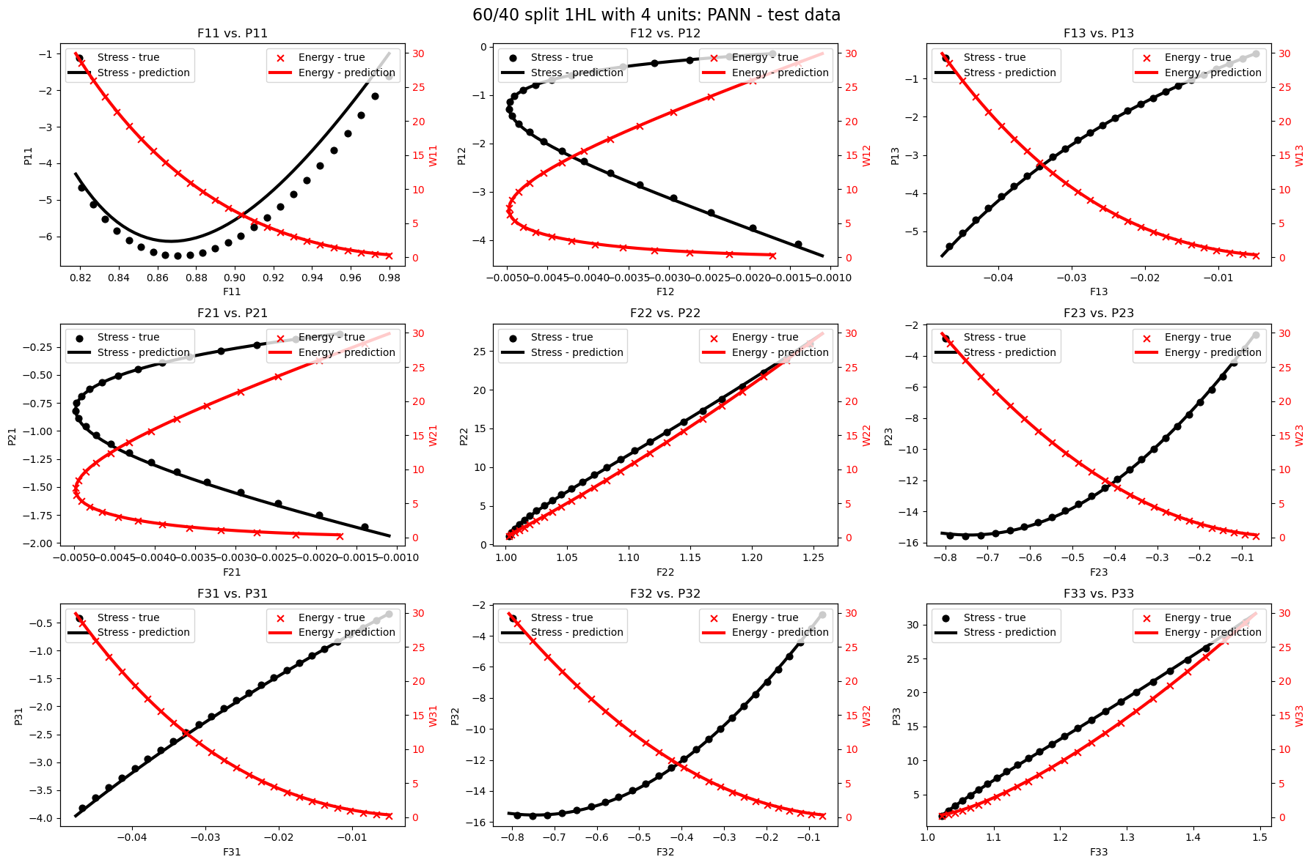
Concentric sampled deformation gradients – Generalization of NN’s
Using a PANN
Excellent generalization behavior already for 60/40 split
Very small NN
The more prior knowledge of physics we put into our model the larger the inductive bias and the less data we need for intra- and extrapolation
Notes:
The results speak for themselves
What does inductive bias mean? The ability of a model that uses a set of assumptions to generalize from limited data

Slide 16
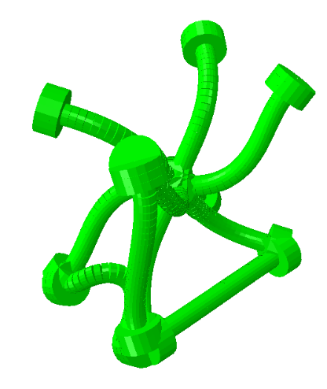
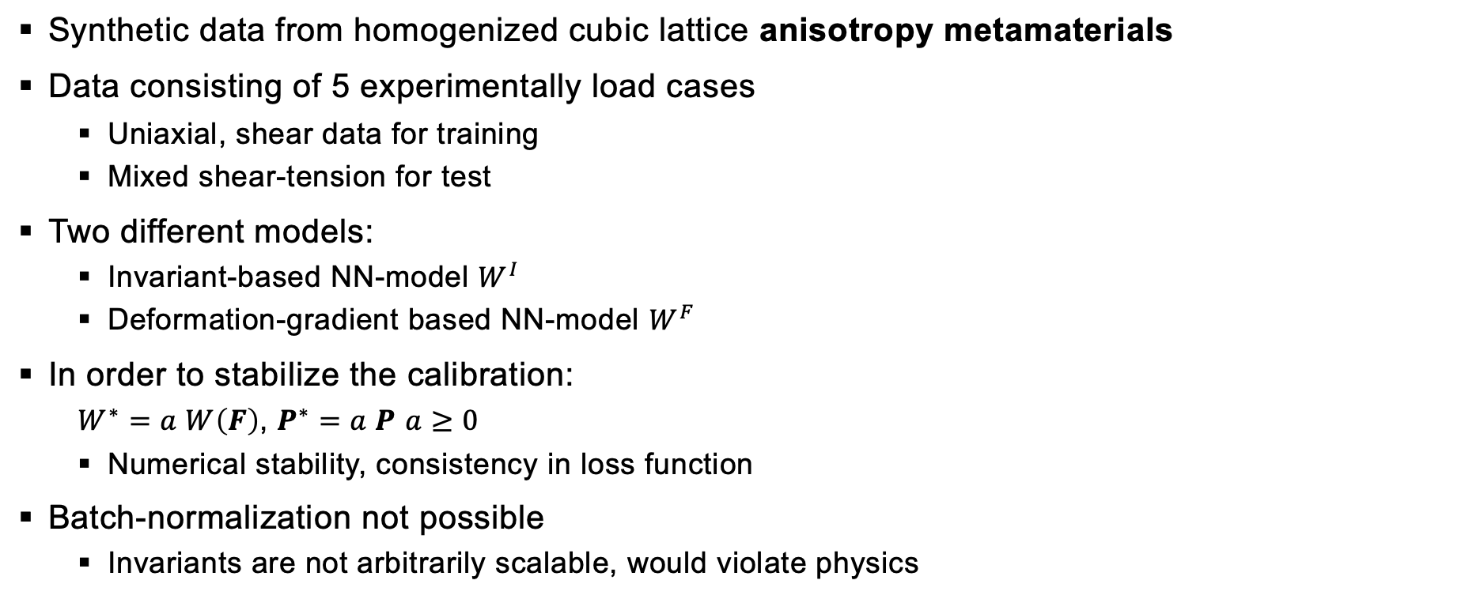
Homogenized cubic lattice metamaterials – Approximation of mathematical conditions
Synthetic data from homogenized cubic lattice anisotropy metamaterials
Data consisting of 5 experimentally load cases
Uniaxial, shear data for training
Mixed shear-tension for test
Two different models:
Invariant-based NN-model $W^{I}$
Deformation-gradient based NN-model $W^{F}$
In order to stabilize the calibration:
$W^{∗}=a W\left(F\right)$, $P^{∗}=a P$ $a≥0$
Numerical stability, consistency in loss function
Batch-normalization not possible
Invariants are not arbitrarily scalable, would violate physics
[2]
[2] https://doi.org/10.1016/j.jmps.2021.104703
Notes:
-In the last task, we now consider anisotropic material behavior with 5 different load cases
We conosider two different models:
Invariant-based Model, very similar to model from task 3
And the deformation-gradient based model
We scale the output in order to stabilize the calibration

Slide 17
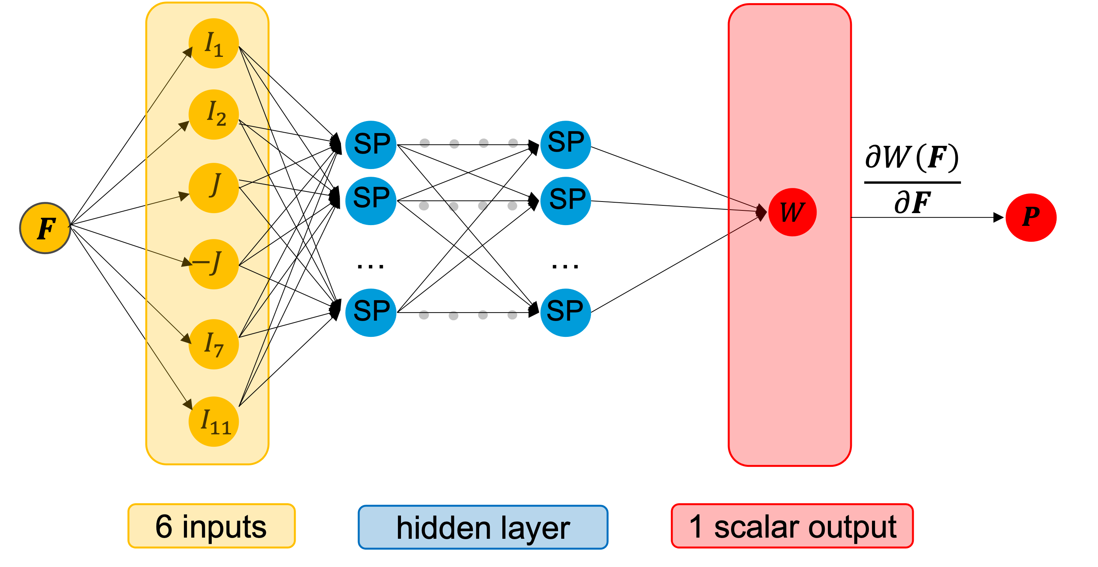
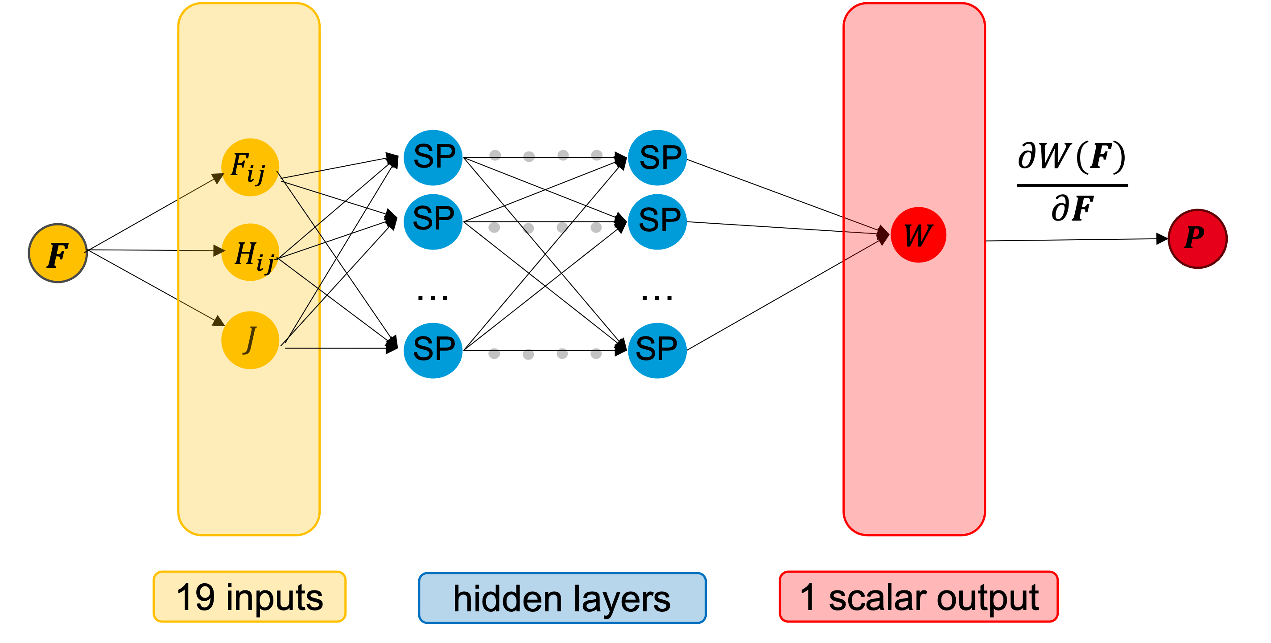
Homogenized cubic lattice metamaterials – models
Objectivity, material symmetry, thermodynamic consistency, polyconvex (ICNN)
Invariant-based PANN
thermodynamic consistency
Objectivity and material symmetry are not fulfilled
Polyconvex (ICNN)
Deformation gradient
based model

Slide 18
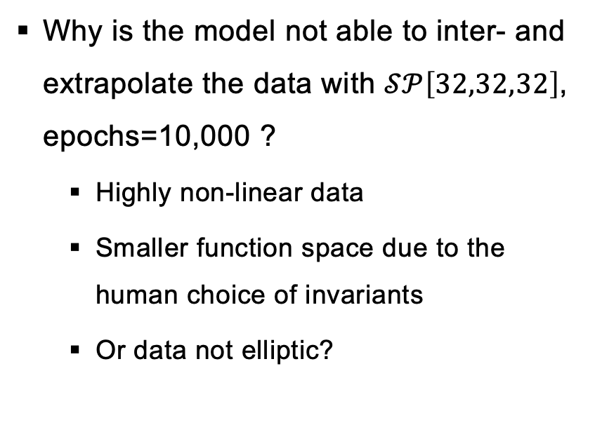
Homogenized cubic lattice metamaterials – Invariant-based model
Why is the model not able to inter- and extrapolate the data with $𝒮𝒫\left[32,32,32\right]$, epochs=10,000 ?
Highly non-linear data
Smaller function space due to the human choice of invariants
Or data not elliptic?
Notes:
You can clearly see that the model fails to represent training data and is not able to extrapolate but why?
- I only used 2 from 5 training data cases
- highly non-linear data
- smaller function space due to the human choice of invariants
However, it is also possible that the data does not fulfill the ellipticity, which can lead to material instabilities

Slide 19
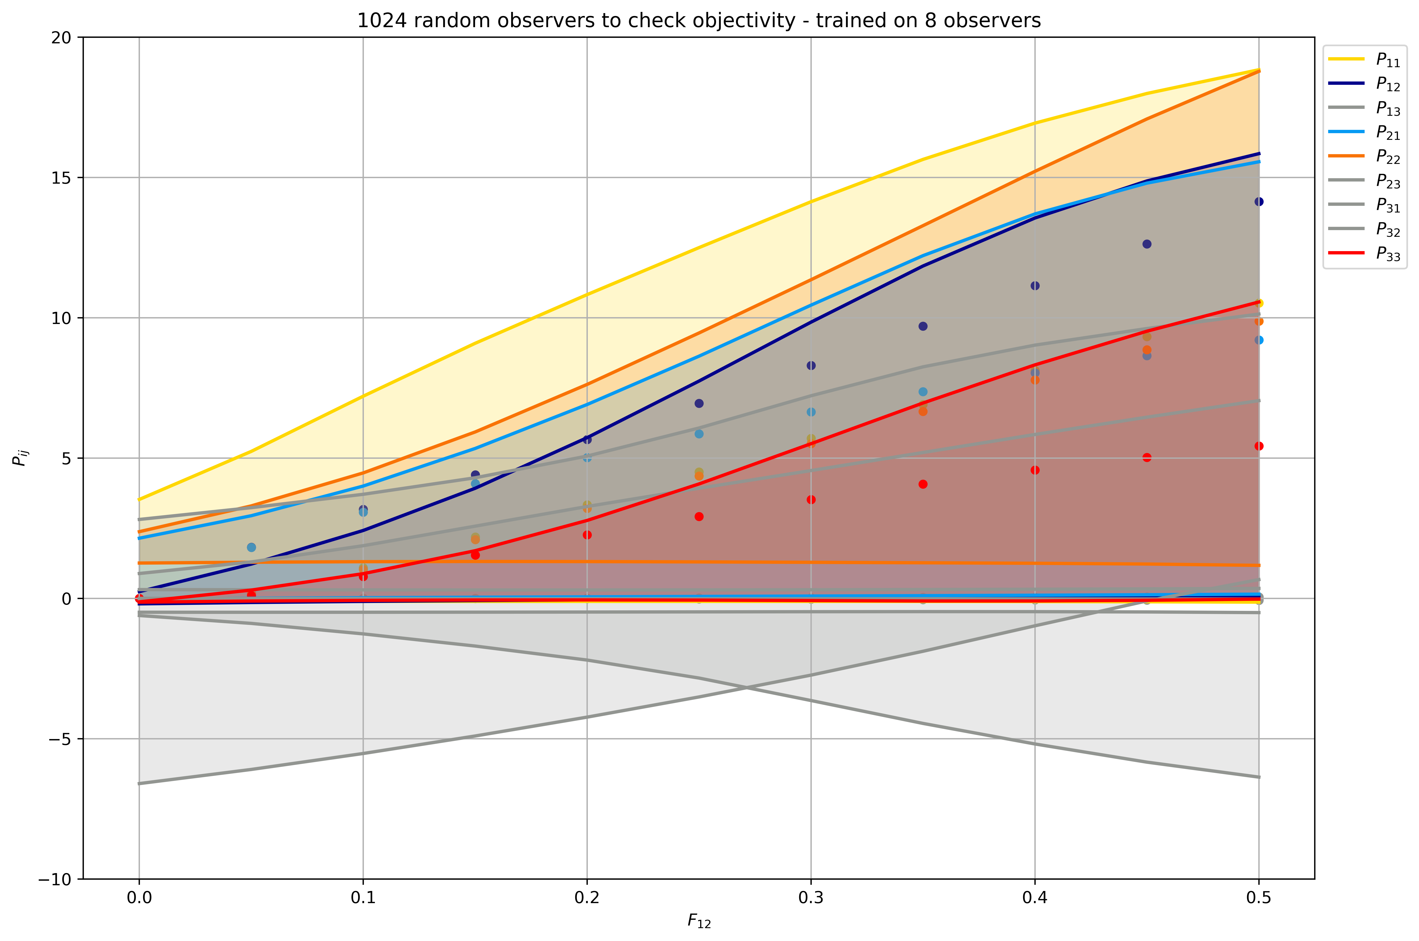
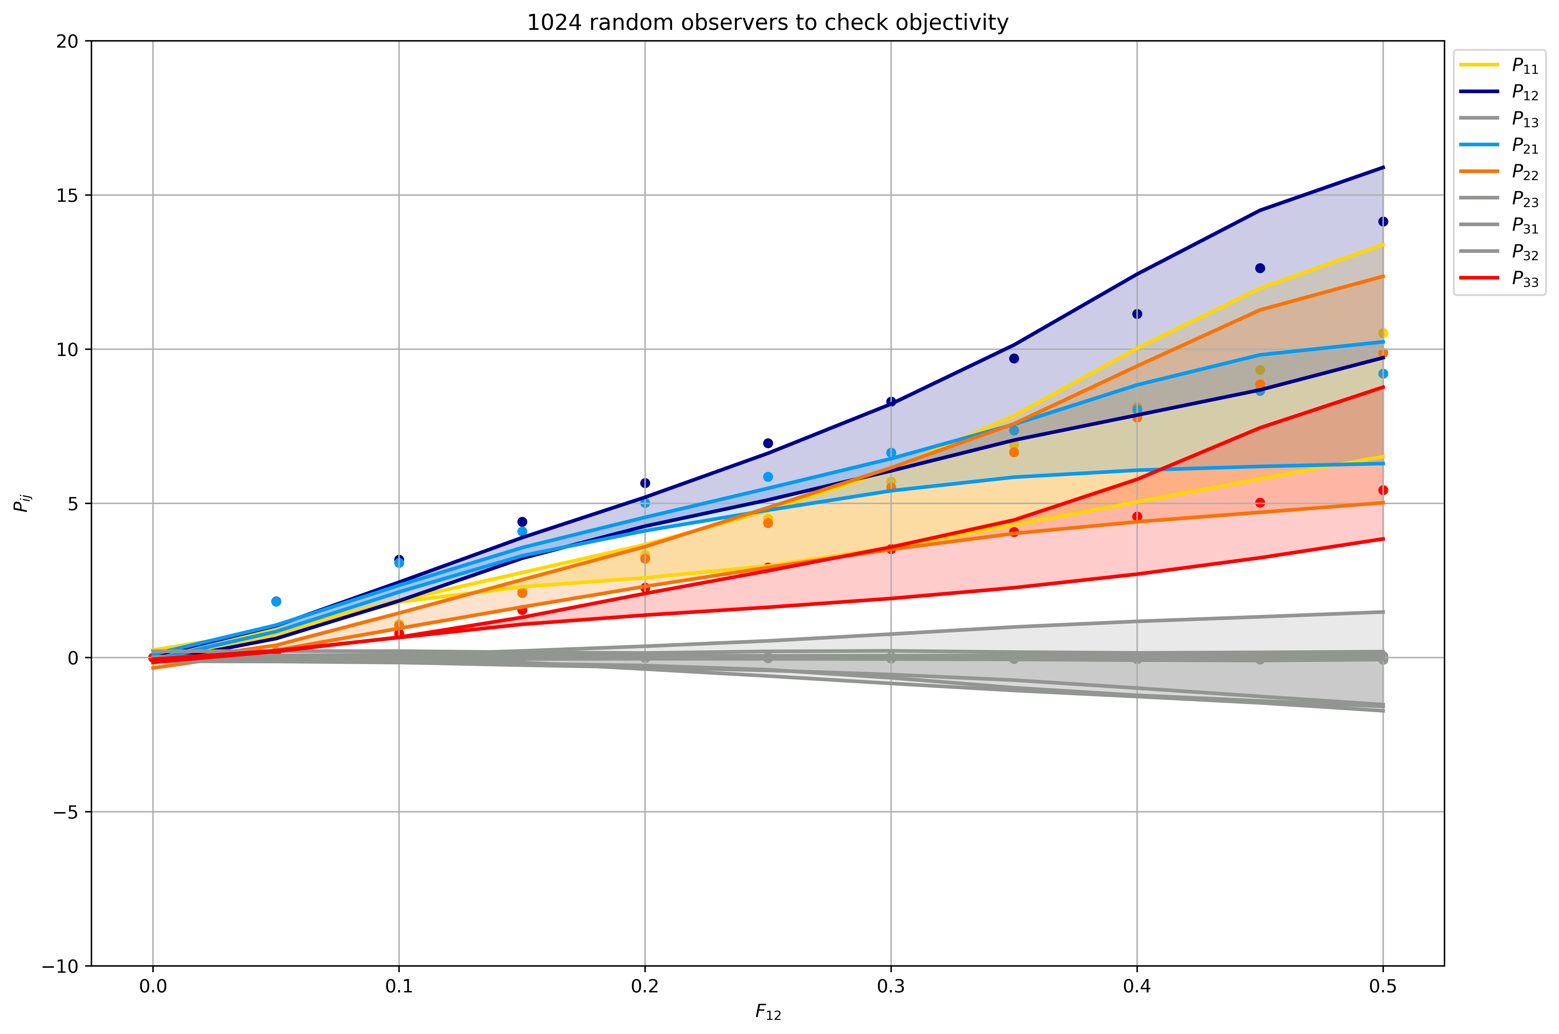
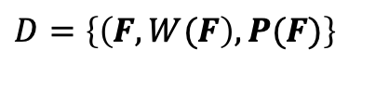
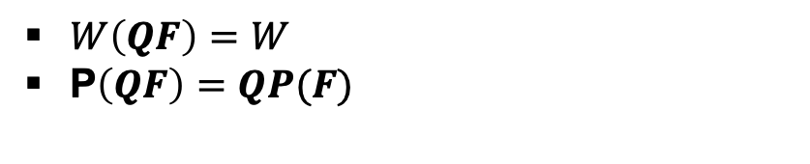
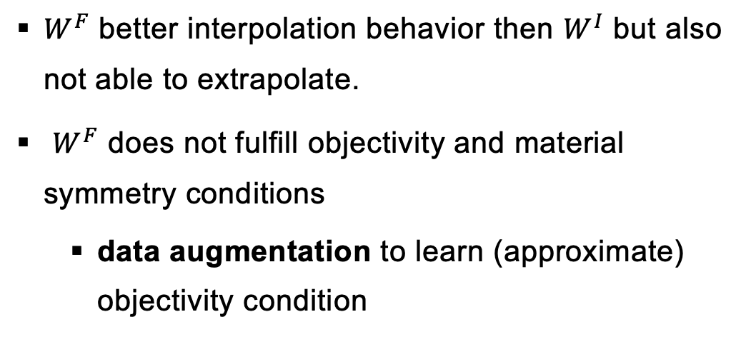
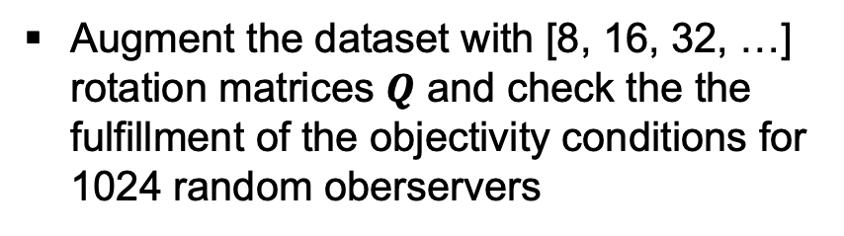
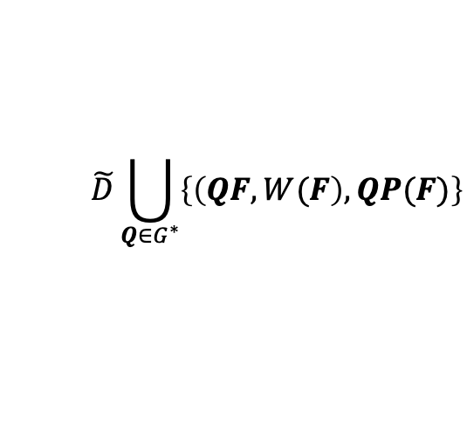
Homogenized cubic lattice metamaterials – Deformation gradient-based model
$W^{F}$ better interpolation behavior then $W^{I}$ but also not able to extrapolate.
$W^{F}$ does not fulfill objectivity and material symmetry conditions
data augmentation to learn (approximate) objectivity condition
$$\tilde{D}\bigcup_{Q∈G^{∗}}{\left\{\left(QF, W(F\right), QP(F)\right\}}$$
$D=\left\{\left(F, W(F\right), P(F)\right\}$
Augment the dataset with [8, 16, 32, …] rotation matrices $Q$ and check the the fulfillment of the objectivity conditions for 1024 random oberservers
$W\left(QF\right)=W$
P$\left(QF\right)=QP(F)$
Pros:
No “extra” data
Physics-aware
Cons:
Training time
Weak sense, not exactly fulfilled
Notes:
The deformation-gradient based model is a little bit better, but also not perfect. As already mentioned the model fulfilles not the objectivity and material symmetry!
The objectivity condition can be approximated though data augmentation.
I augmented the training data with 8, 32 and 64 rotation matrices and test the objectivity with 1024 random observers

Slide 20





Homogenized cubic lattice metamaterials – Deformation gradient-based model
$W^{F}$ better interpolation behavior then $W^{I}$ but also not able to extrapolate.
$W^{F}$ does not fulfill objectivity and material symmetry conditions
data augmentation to learn (approximate) objectivity condition
$$\tilde{D}\bigcup_{Q∈G^{∗}}{\left\{\left(QF, W(F\right), QP(F)\right\}}$$
$D=\left\{\left(F, W(F\right), P(F)\right\}$
Augment the dataset with [8, 16, 32, …] rotation matrices $Q$ and check the the fulfillment of the objectivity conditions for 1024 random oberservers
$W\left(QF\right)=W(F)$
P$\left(QF\right)=QP\left(F\right)$
Pros:
No “extra” data
Physics-aware
Cons:
Training time
Weak sense, not exactly fulfilled

Slide 21
Thank you for your attention!

Slide 22
Constitutive conditions for hyperelasticity models
Notes:
Hyperelasticity is a non-linear elastic material behavior that can be described by these constitutive conditions. These conditions are very important which which is why I would like to briefly present them again here

Slide 23
Constitutive conditions for hyperelasticity models
Not considered in this tutorial!

Slide 24








Neural network model – A naïve approach
$$C_{11}$$
$$C_{12}$$
SP
SP
$$C_{13}$$
SP
SP
$$C$$
$$P$$
$$C_{22}$$
…
…
SP
SP
$$C_{23}$$
$$C_{33}$$
6 inputs
hidden layer
output layer

Slide 25










Invariant-based model – Model for cubic anisotropy metamaterial
$$I_{1}$$
$$I_{2}$$
SP
SP
$$\frac{∂W\left(F\right)}{∂F}$$
$$J$$
SP
SP
$$F$$
$$W$$
$$P$$
$$−J$$
…
…
SP
SP
$$I_{7}$$
$$I_{11}$$
6 inputs
hidden layer
1 scalar output

Slide 26










Physics-augmented neural network model (PANN)
$W$ expressed in terms of invariants of $C= F^{T}F$
$$W\left(F\right)≡W\left(C\right)≡W\left(I_{1},J,I_{3}, I_{4},{ I}_{5}\right)$$
$I_{1}=tr C$, $J=\det{F}$, $I_{4}=tr (CG_{ti})$, $I_{5}=tr (CofCG_{ti})$
Polyconvexity:
Using polyconvex invariants
Convex and non-decreasing activation function already in the first hidden layer (exception for J => convex activation function but not necessarily non-decreasing)
Non-negative weights in all layers
$$I_{1}$$
$$J$$
SP
SP
$$\frac{∂W\left(F\right)}{∂F}$$
SP
SP
$$W$$
$$P$$
$$F$$
$$−J$$
…
…
$$I_{4}$$
SP
SP
$$I_{5}$$
5 inputs
hidden layers
1 scalar output

Slide 27







Deformation-gradient based neural network
Polyconvexity:
Convex and non-decreasing activation function in all layers
Non-negative weights all in layers (but with arbitrary weights in the first hidden layer)
$$F_{ij}$$
SP
SP
$$\frac{∂W\left(F\right)}{∂F}$$
SP
SP
$$W$$
$$P$$
$$F$$
$$H_{ij}$$
…
…
$$J$$
SP
SP
19 inputs
hidden layers
1 scalar output

